Slide 1
Johns Hopkins Hospital
Student name
Course/Section Number
Semester

Slide 2
Overview
(Johns Hopkins Hospital)
Johns Hopkins Hospital is among the most renowned hospitals offering quality patient care that serves the expansive Baltimore and the global communities.
The hospital doubles as a biomedical research center and a teaching hospital for Johns Hopkins School of Medicine.
The hospital is headquartered in Baltimore (Maryland) in the United States of America and was founded by Johns Hopkins in 1889.
Hopkins was a businessman and also a philanthropist.
It also has a separate center that carter for children and teenagers (Johns Hopkins Hospital, 2020).

Slide 3
Overview
The hospital has six academic and medicine community hospitals, several suburban surgery and health care centers, and more than 50 home care services and specialty care practices.
Its organizational structure includes various positions such as president, managing director, and senior vice president, among others (Johns Hopkins Hospital, 2020).
The hospital registered $ 2.5 billion in annual revenue, with the Baltimore hospital contributing over 500,000 in 2019 (Johns Hopkins Hospital, 2020).

Slide 4
Overview
The mission of the hospital is "to improve the health of the community and the world by setting the standard of excellence in medical education, research and clinical care" (Blitz, Ahmed, & Rigamonti, 2018).
The hospital's vision is "to push the boundaries of discovery, transform health care, advance medical education, and create hope for humanity; Together, we will deliver the promise of medicine."
The hospital's corporate-level goals are "to maximize value for the patients we serve with an intense focus on quality, safety, and efficiency."
Its marketing objective is to inform people facing complex medical situations to understand that they can greatly benefit from the discovery research and innovations carried out at Johns Hopkins hospital (Johns Hopkins Hospital, 2020).

Slide 5
1. SWOT analysis
Strengths
The hospital has a formidable experience in clinical for a very long time.
The hospital provides top-notch healthcare (Blitz, Ahmed & Kigamonti, 2018).
The hospital is a major epidemiological and referral center for the Washington metropolitan region.
It is also a solid teaching and research center, with every hospital having a medical University.
The hospital enjoys a favorable position as a government contractor for international epidemiological campaigns and social marketing (Kirsch et al., 2020).
It also offers competitive benefits in its job offers.

Slide 6
Weaknesses
The hospital scores poorly in terms of its coverage of the disadvantaged people in society.
The hospital score slow in offering services in heart surgery and cardiology, oncology, pulmonology, orthopedics, gynecology, endocrinology, and nephrology.
The hospital is not among the top medical centers in dealing with the dread disease in Europe and North America.
Departments at the hospital seem to be reluctant to focus on the engagement of its employees.
Employees feel isolated and not valued by the management
Other organizations seem to have better compensation as compared to Johns Hopkins (Kirsch et al., 2020).

Slide 7
Opportunities
It stands a chance to in advancing in the filmless acquisition of data, transport, monitoring, retrieval, display, and storage.
The hospital also has open channels for extensive usage of wireless terminal and tablet personal computers.
It has vast opportunities for expanding in the use of electronic health records
It can use surveys on employee engagement to enhance employee engagement levels
It can also come up with mechanisms of recognizing employees' accomplishments as a way of motivating them.
It has the chance to acquire optimal compliance with the insurer and the regulatory requirements
It can also improve the assembling of teaching materials in radiology, improved employee retention, and better communication with the medical staff

Slide 8
Threats
The hospital faces threats associated with the 2011 and 2912 national regulations pertaining to non-usage penalties on Medicaid and Medicare.
The ratio of its PAC's cost-benefit is doubtful. The costs have sharply reduced since 1990.
It faces stiff competition from other organizations providing the same medical and education services. They include The Mayo Clinic, Memorial Sloan-Kettering cancer center (New York), and Cleveland clinic.
The hospital also suffers from stiff competition in giving higher compensation to reduce employee turnover.

Slide 9
2. Target market
Clients for biomedical centers prefer well-equipped centers that are well equipped and modern technological medical equipment that can enhance accurate medical examinations and enhance learning.
Clients also have a belief that any medical condition deserves the necessary medical attention.
They do not wait for the condition to worsen before seeking medical attention.
Most of them believe that referral medical centers are expensive but offer high-quality services that can sustain life.
The majority of the health seekers (especially for chronic illnesses) are either underinsured or non-insured.
They lack the necessary funds to afford the needed quality of healthcare.
Another barrier is the lack of information about all the medical services provided in the market (Young & Kroth, 2017).
They also learn the need to seek medical attention based on the data on mortality and disability due to the medical conditions.

Slide 10
Target Market
The clients in the target market value quality healthcare and their safety.
Medical centers with a positive reputation for patient safety attract the trust of most of the clients.
They will also refer their family members and colleagues to such centers.
Clients value medical centers that give them undivided attention that can enhance their recovery and satisfaction.
The target market has a population marked with high heart-related illnesses, for instance, stroke, high blood pressure, and cardiac arrest.
The population is also marked with a higher prevalence of lifestyle-related diseases, for instance, obesity and diabetes.

Slide 11
3. Value Proposition and competitive positioning
Johns Hopkins Hospital attracts students from all corners of the USA and the world because of the hospital's extensive research platforms and education opportunities.
The strategy has revolutionized new methods of teaching and practicing medicine.
The hospital management believes in diversity.
It has employees from different cultures, backgrounds, and races (Johns Hopkins Hospital, 2020).
It also addresses possible barriers to diversity and service delivery.
The hospital has a team of analysts who develop medical plans to offer personalized support to patients.
The hospital works with other organizations to advance its technological application, come up with health plans, and implement remedies that are capable of influencing health behaviors.

Slide 12
Value Proposition and competitive positioning
The hospital is striving to ensure that it has competent expertise and modern equipment to enhance quality gynecology and neurology services.
Its University adjusted its clinical groups to enhance individual educational achievements (Young & Kroth, 2017).
Johns Hopkins hospital has nearby competitors who are in similar geographical lines and also healthcare business.
The competitors include Lifebridge health, Kennedy Krieger Children's Hospital, Northwest Hospital Center, and Mount Washington Pediatric Health System.

Slide 13
4. Product strategies
The service products include; Specialty care services which range from prevention to surgeries, emergency care, primary care that deals with minor illnesses to chronic conditions, children center, and pharmacies.
The patient experience is positive because all patients receive high-quality care that is safe, responsive, and compassionate to their needs.
Its products and experience differ from competitors because it has a university, a surgical facility, and a pediatric specialist (Jain & Choudhary, 2013).
The role of quality in the patient experience is that it makes the patient adhere to the medical advice given.
The product is a brand created with high standards for the web, digital, print, signs, and several applications.
I recommend changes to be made on the employees' side; they should be more valued and much involved for better results.

Slide 14
5. Price Strategies
The hospital uses market information and forces and other competitive pricing mechanisms to set rates for its services.
It sets the prices twice every year, although it affirms that the prices are subject to abrupt changes.
The medical charges are based on the patient's insurance coverage, actual medical services provided, individual needs, and the physician's treatment choices.

Slide 15
Price Strategies
Johns Hopkins Hospital University charges around $ 67 650 for attendance.
The fee includes accommodation, tuition, and board.
Being a private university, the price does not vary for the local and international students.
The University does not provide a scholarship for the National Merit Scholarship beyond the normal scholarship of $2,500.
The University's fee plan is a student-centered.
It offers an average merit award of $925.
Students who receive merit aid pay $ 66,725 (Jain & Choudhary, 2013).

Slide 16
6. Place (distribution strategies)
The hospital is strategically situated in Baltimore (the largest city in Maryland), where a large population of Maryland can easily access the hospital.
It is also surrounded by recreational facilities and offices.
It operates 24 hours a day.
The hospital acquires medical supplies directly from certified manufacturers and distributors.
I consider a channel network to be a value network because it ensures a steady supply of the needed products as opposed to hick-ups associated with intermediaries.
Also, the channel offers relatively lower prices.
To ensure a value network system, Johns Hopkins hospital should increase its automation to reduce human involvement and eliminate errors.
The hospital should also invest heavily in cloud computing and other modern applications.

Slide 17
7. Promotion
(marketing communications) strategies
The hospital also doubles as the research center for Johns Hopkins School of Medicine.
This helps the hospital to increase its interactions with people from all walks of life.
The hospital needs to increase the use medical of medical camps in checking the general health of people from its locality to other states and, if possible, go global.
The hospital's communications message is reflected in its vision statement, "to improve the health of the community and the world by setting the standard of excellence in medical education, research and clinical care."
The message effectively represents the medical and educational services that the hospital provides. The message is strategically related via its vision.

Slide 18
Promotion
(marketing communications) strategies
The marketing tools used include the use of billboards in airports and the use of digital platforms, for instance, Facebook, Twitter, and Linkedin (Johns Hopkins Hospital, 2020).
The hospital has a vast international catchment area.
It should start advertising using local Television stations in other targeted nations to increase its market base internationally.
The hospital has excellent customer relations mechanisms.
These mechanisms include customer service representatives, and patient feedback office that offers guest and volunteer services, and staff members who are needed to give extra special care and help to clients.

Slide 19
8. Measurements
The hospital's marketing activities measure the success of reaching the objectives based on the number of new patients that the hospital received in 2019.
The hospital registered 2700 new patients in 2019 in all its branches.
Out of the 2700 patients, 309 were direct referrals by loyal clients (Johns Hopkins Hospital, 2020).
In 2019, the annual revenue of the hospital grew by 2.9 % to $5 billion.

Slide 20
Conclusion
The hospital is doing well in the hospital industry.
It should strive to increase funds in expanding its acute shortage of beds.
More funds need to be allocated towards enhancing new technologies, especially in services that its competitors are more competent in.
The hospital should also consider its employees as an important part of the institution.
It needs to improve its engagement level with the employees, for instance, through forming a committee to address their concerns.
This will help curb the high isolation rate that is causing employee turnover and a decrease in teamwork.
The management needs to focus on extensive marketing of the hospital and its University on the international platform to enhance expansion.

Slide 21
References
Blitz, A. M., Ahmed, A. K., & Rigamonti, D. (2018). Founder of modern hydrocephalus diagnosis and therapy: Walter Dandy at the Johns Hopkins Hospital. Journal of neurosurgery, 131(4), 1046-1051.
Jain, A., & Choudhary, V. (2013) The Impact of Marketing Mix Strategy on Hospital's Performance Measured by Patient's Satisfaction. IITM Journal of Management and IT, 70.
Johns Hopkins Hospital. (2020). Harriet Lane Handbook International Edition: The John Hopkins Hospital. Elsevier-Health Science.
Kirsch, T. D., Reed, P., Kandra Strauss-Riggs, M. P. H., & Sauer, L. (2020). Strengths, weaknesses, opportunities, and threats that impact disaster health research. American Journal of Disaster Medicine, 15(3), 169-185.
Young, K. M., & Kroth, P. J. (2017). Sultz & Young's Health Care USA. Jones & Bartlett Learning.

Slide 22
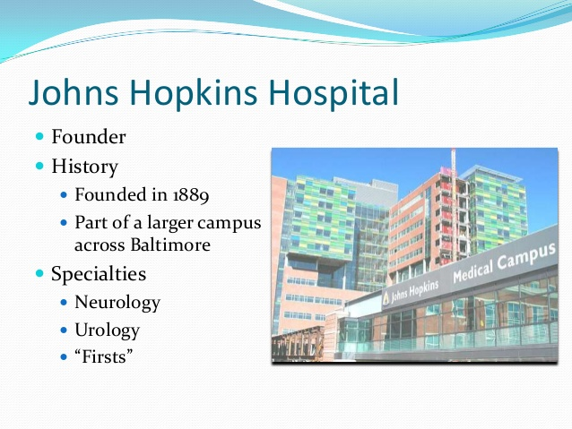
Exhibits

Slide 23
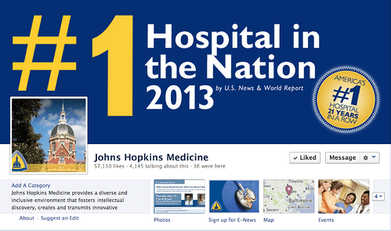
Exhibit

